Slide 1
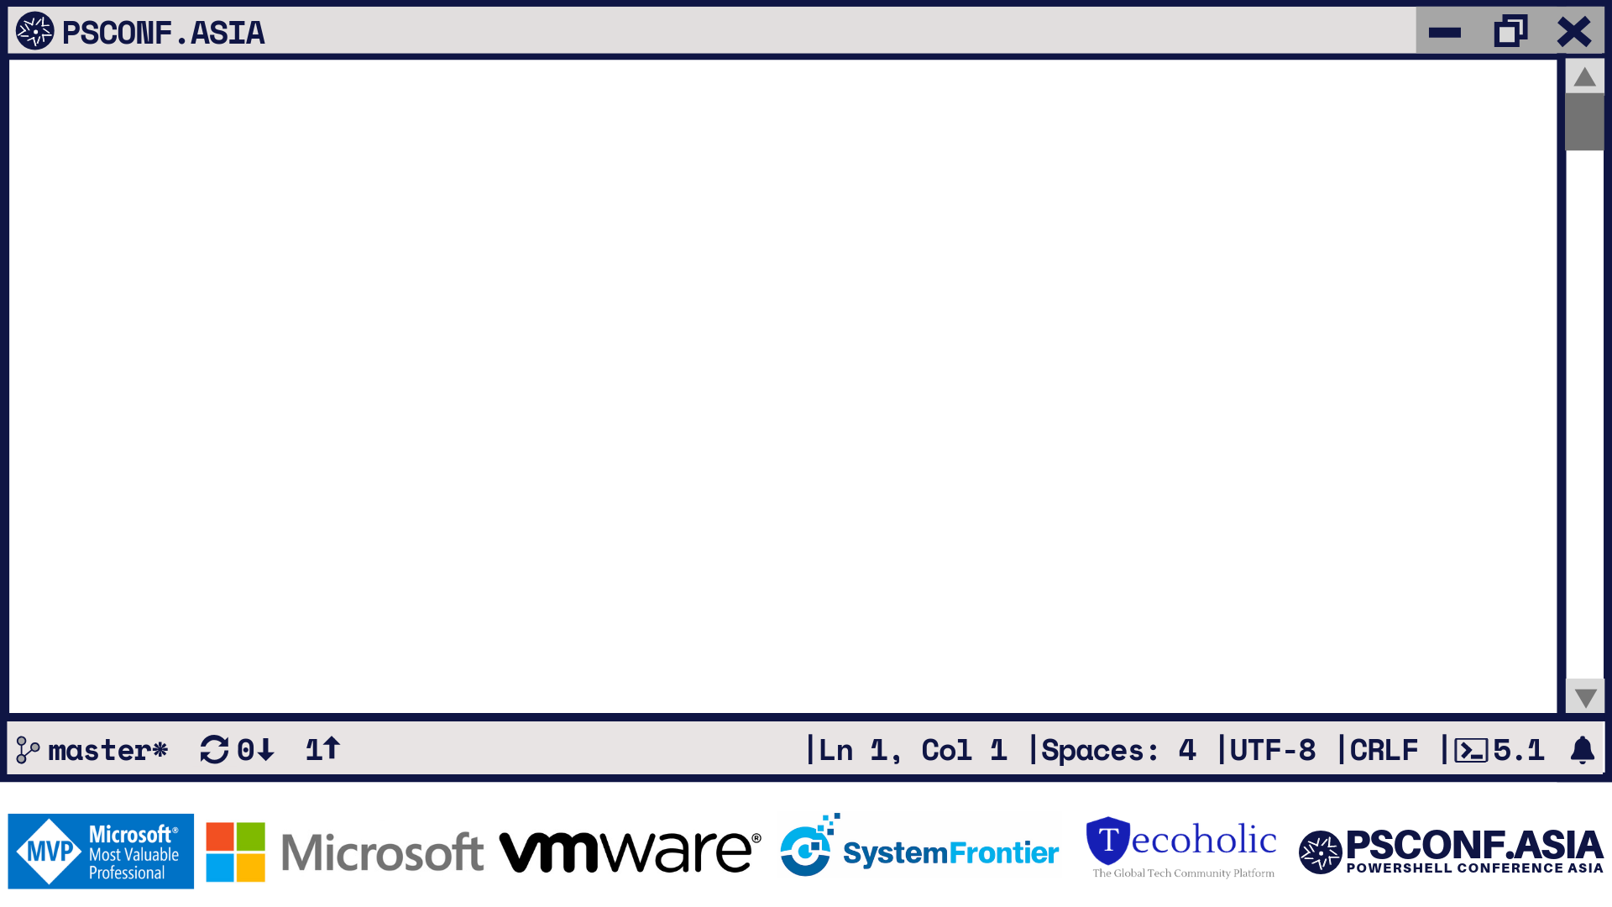
PowerCLI Workshop From Beginner to Advanced
Luc Dekens
Kyle Ruddy

Slide 2
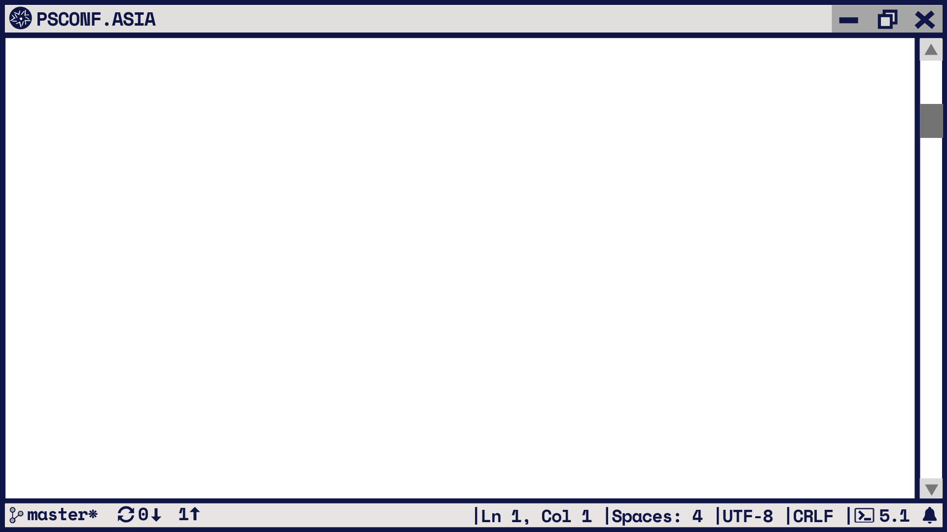
Luc Dekens
PowerCLI Mastermind
Writer
GitHub
Twitter
MS MVP
@ lucd.info
@ github.com/lucdekens
@lucd22
Cloud\Datacenter Management

Slide 3
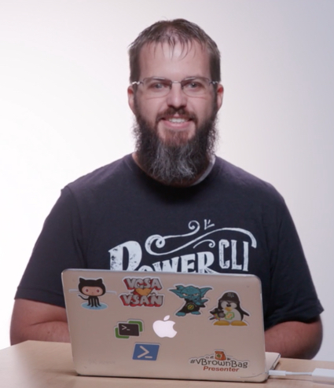
Kyle Ruddy
Senior Architect, Technical Marketing
Writer
GitHub
Podcast
Twitter
MS MVP
@ kmruddy.com
@ github.com/kmruddy
@ vBrownBag.com
@kmruddy
Cloud\Datacenter Management

Slide 4
Agenda
What are PowerShell and PowerCLI?
The Lingo Dictionary
Setup and Configuration
Starting to Code
Writing Logic Statements
Lab Time

Slide 5
What are PowerShell and PowerCLI?

Slide 6
“Windows PowerShell is a task automation and configuration management framework from Microsoft, consisting of a command-line shell and associated scripting language built on the .NET Framework.”
https://en.wikipedia.org/wiki/Windows_PowerShell

Slide 7
PowerShell
A simple and straight-forward path to automation
Already installed on all modern Windows Operating Systems
Integrated and rich help system
PowerShell 6.0 (aka. Core) available for Linux and MacOS
https://github.com/PowerShell/PowerShell

Slide 8
PowerShell
Modular and object-oriented
The best of a programming language melded with a scripting language
True portability of code via modules (and snap-ins)
Objects = Properties + Methods

Slide 9
VMware PowerCLI
VMware’s command-line and scripting tool built on Windows PowerShell
Features more than 700 cmdlets for managing and automating vSphere, vCloud, and Horizon environments
One of the most robust and complete PowerShell deployments in the world
Over 10 years “young”!

Slide 10
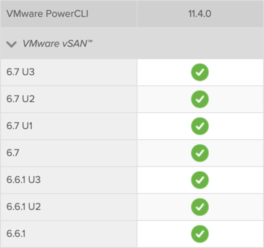
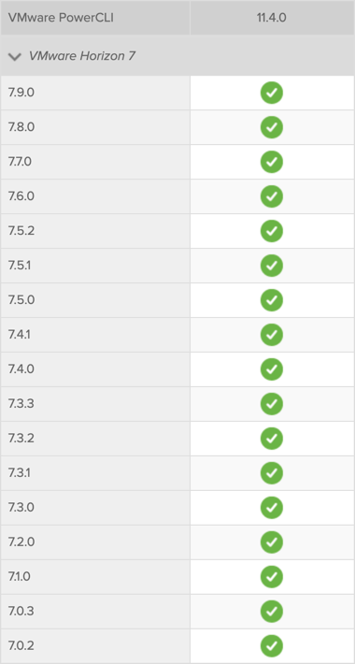
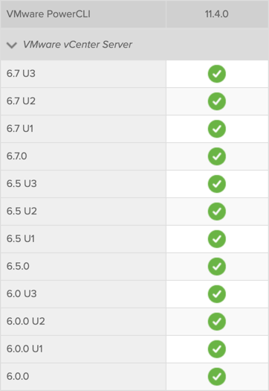
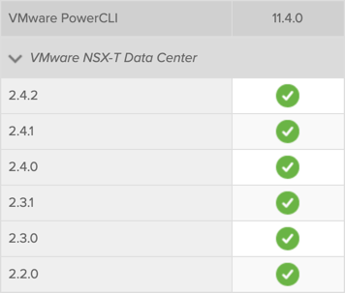
PowerCLI Compatibility

Slide 11
The Lingo Dictionary

Slide 12
Common Terms
Cmdlet (“Command let”)
A single command
Usually written and compiled in .NET
Function
A single command
Usually written in PowerShell
Script
Series of commands stored in a PS1 file
Module
Package of related commands

Slide 13
Command Structure
Cmdlets and Functions use properly formatted verbs
Use Get-Verb to see the available options
Most features follow a very simple pattern
Get = Gather data
Set = Change data
New = Create data
Remove = Delete data

Slide 14
Object Management
Variable
Saves objects for later reference
Uses ‘$’ as the initial character
Example: $Name = “Kyle Ruddy”
Pipeline
Passes objects from one command to the next
Declared with ‘|’ character
Example: Get-User –Name $Name | Get-Beard

Slide 15
PowerCLI Object Management
PowerShell and PowerCLI work with objects
Not all objects are equal
.Net objects
vSphere objects
.Net objects | vSphere objects
PowerCLI cmdlet | PowerCLI cmdlet – indirect
Selection of properties | All vSphere properties
PowerCLI methods | All vSphere methods
Get-Help/Get-Command | API Reference
Starter + Intermediate | Intermediate + Advanced

Slide 16
Setup and Configuration

Slide 17
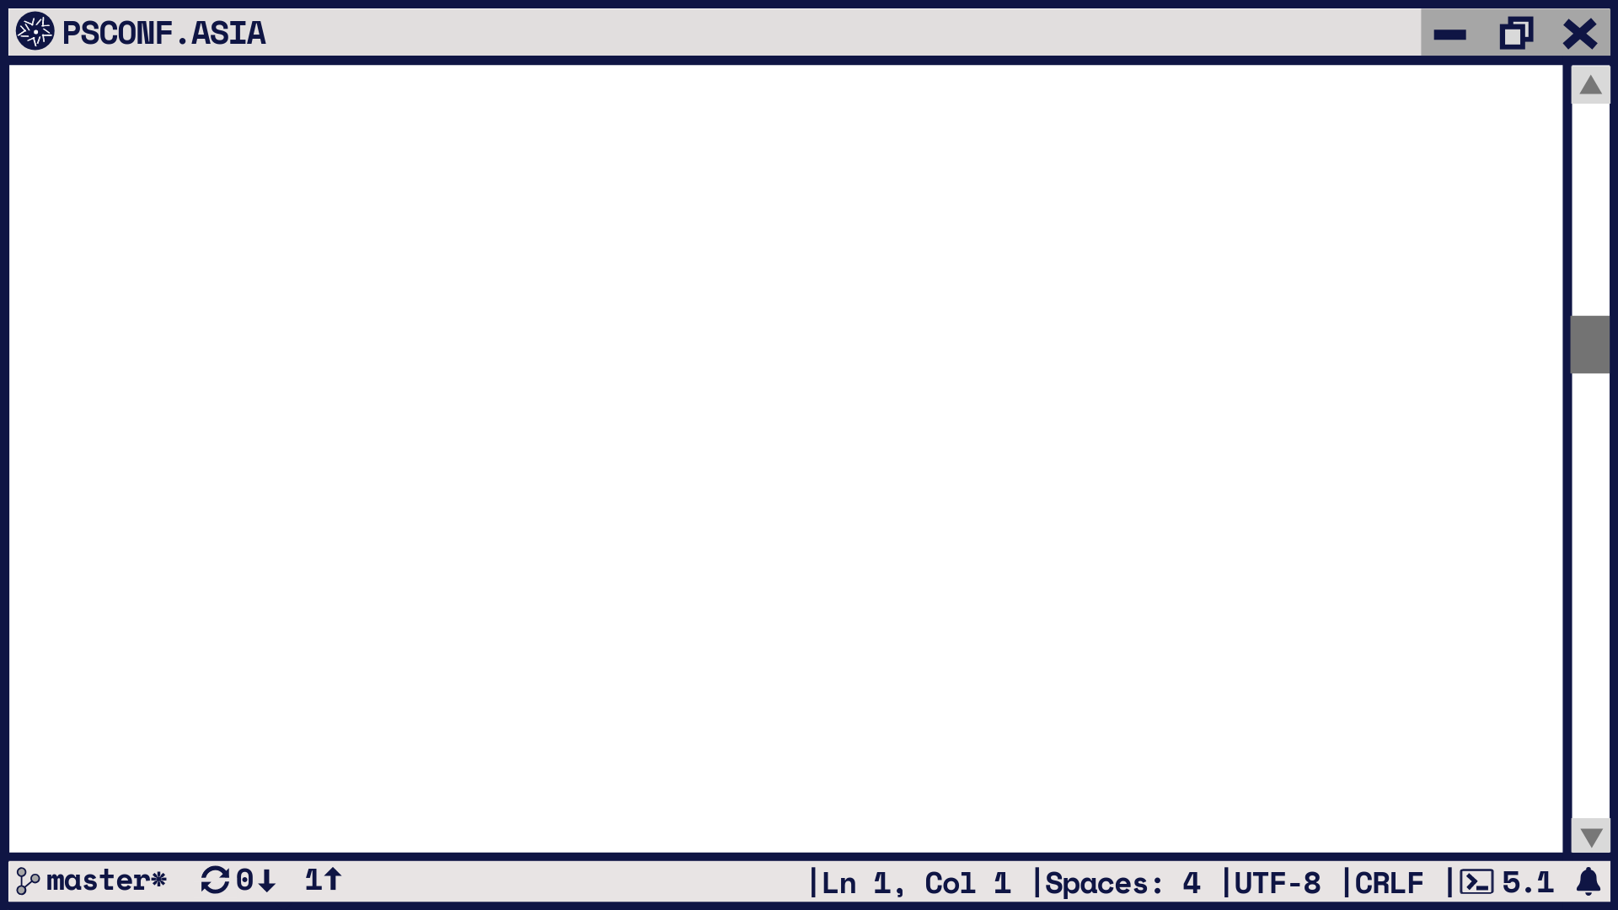
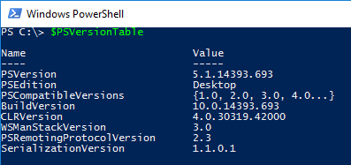
Setting Up PowerShell
Native to all modern Windows deployments
Latest version is 5.1
Use $PSVersionTable to see what you’re running

Slide 18
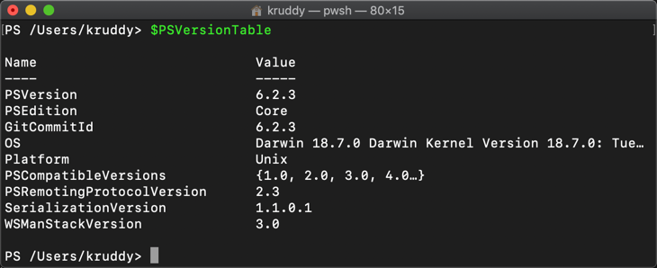
Setting Up PowerShell Core
Available through most package managers
Latest version is 6.2.3
Use $PSVersionTable to see what you’re running

Slide 19
Installation of PowerCLI is from the PowerShell Gallery
and is done directly from within PowerShell
Prerequisites:
PowerShell 5.x (OR manually install PowerShellGet)
Uninstall PowerCLI 6.5 R1 (OR any other previous versions)
Internet Connectivity
Installation:
Open a PowerShell Session
Run: Install-Module VMware.PowerCLI -Scope CurrentUser
Modules are deployed to: $home\Documents\WindowsPowerShell\Modules

Slide 20
Starting to Code

Slide 21
Safe vs Non-Safe Commands
Suggest starting with cmdlets that pull or display data
These are “Safe” in that they are unable to modify data
This is helpful for learning the PowerShell syntax
Which… is a never ending journey!

Slide 22
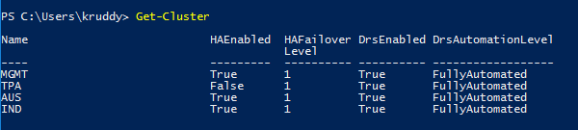
Identify Safe Commands
Safe means that there is no data modification

Slide 23
Additional Safeguards
Whatif
Shows you what WOULD happen without actually modifying data
Switch
Confirm
Asks you to confirm before any changes are made
Boolean ($true or $false)

Slide 24
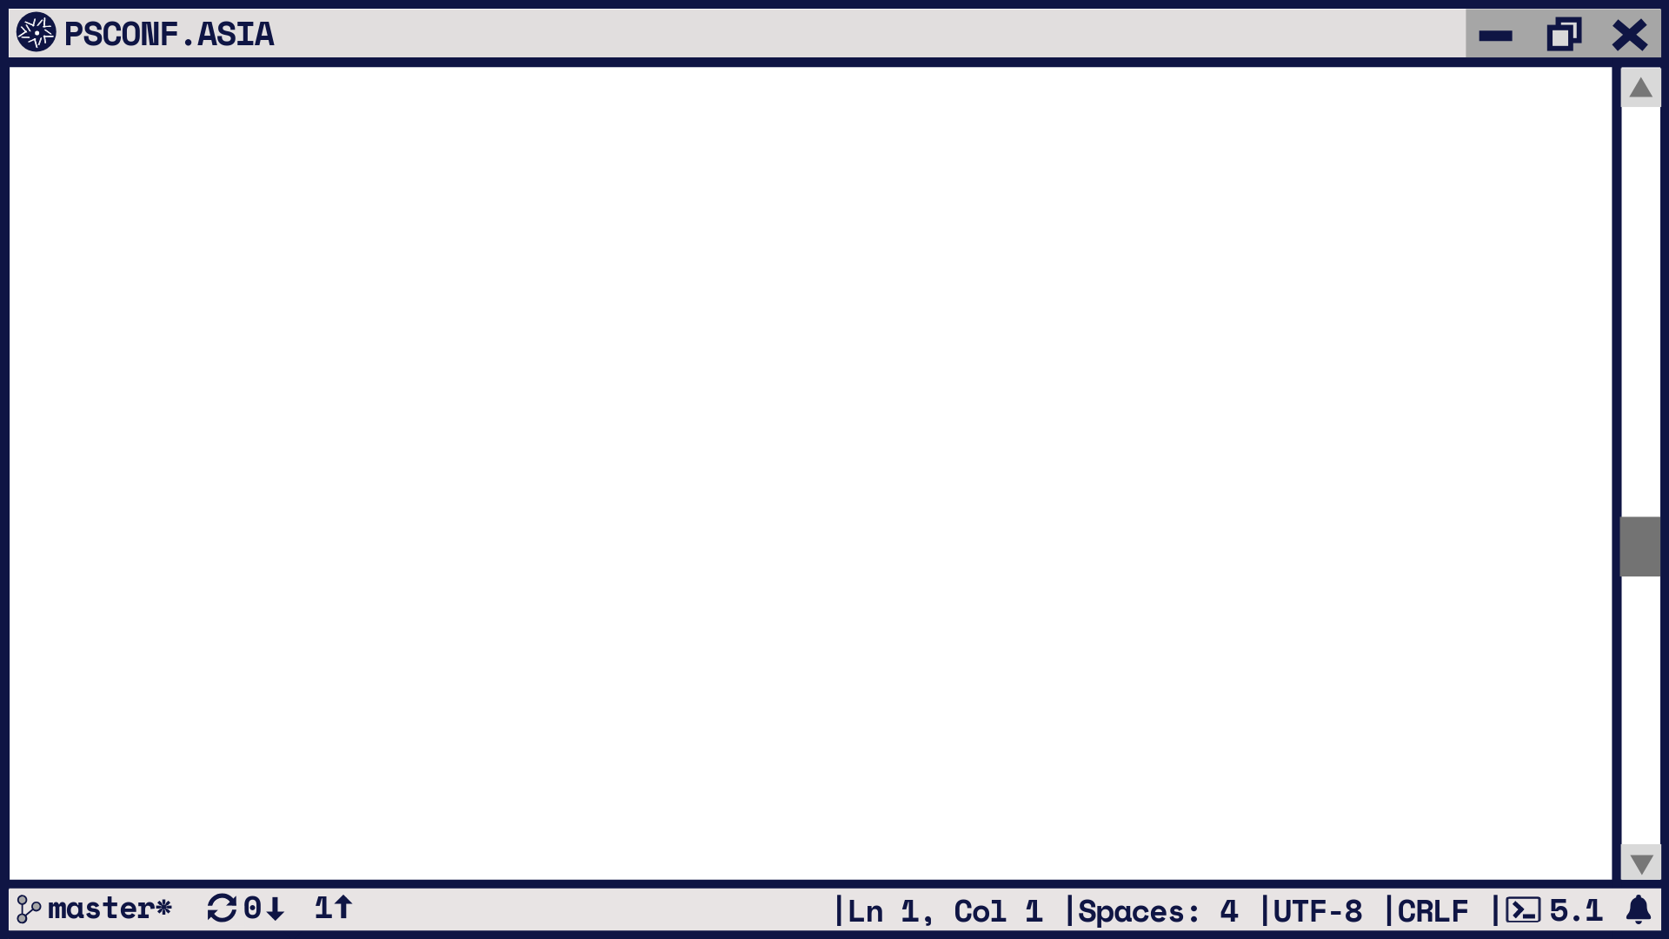
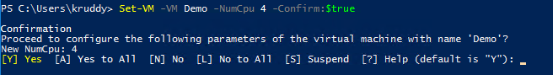
Additional Safeguards

Slide 25
Writing Logic Statements

Slide 26
Sample Use Case
Cluster configuration
What values are currently configured?
Changing a few of them to match our desired state
DRS Settings
HA is Enabled
DRS Automation Level is Fully Automated

Slide 27
Gathering Cluster Data
# Variables
$cluster = ‘Cluster Name’
# Gather Cluster Data
$clusterConfig = Get-Cluster –Name $cluster

Slide 28
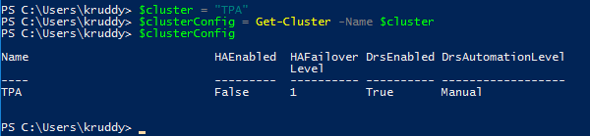
Gathering Cluster Data

Slide 29
Decision Making Logic
#Adding logic to test values
if ($clusterConfig.DrsAutomationLevel –ne ‘FullyAutomated’) {
# Display a warning message indicating the DRS Automation level is incorrect
Write-Warning –Message ‘DRS Automation Level is wrong!’
}

Slide 30
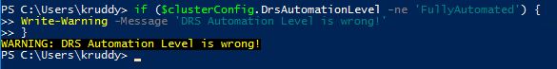
Decision Making Logic

Slide 31
Decision Making Logic
# Add logic to modify these values
if ($clusterConfig.DrsAutomationLevel –ne ‘FullyAutomated’) {
# Display a warning message that the DRS Automation level is incorrect
Write-Warning –Message ‘DRS Automation Level is wrong!’
# Change the cluster configuration to be the proper level for DRS
Set-Cluster –Cluster $cluster –DrsAutomationlevel FullyAutomated
}

Slide 32
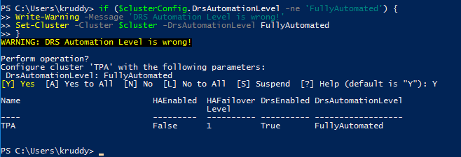
Gathering Cluster Data

Slide 33
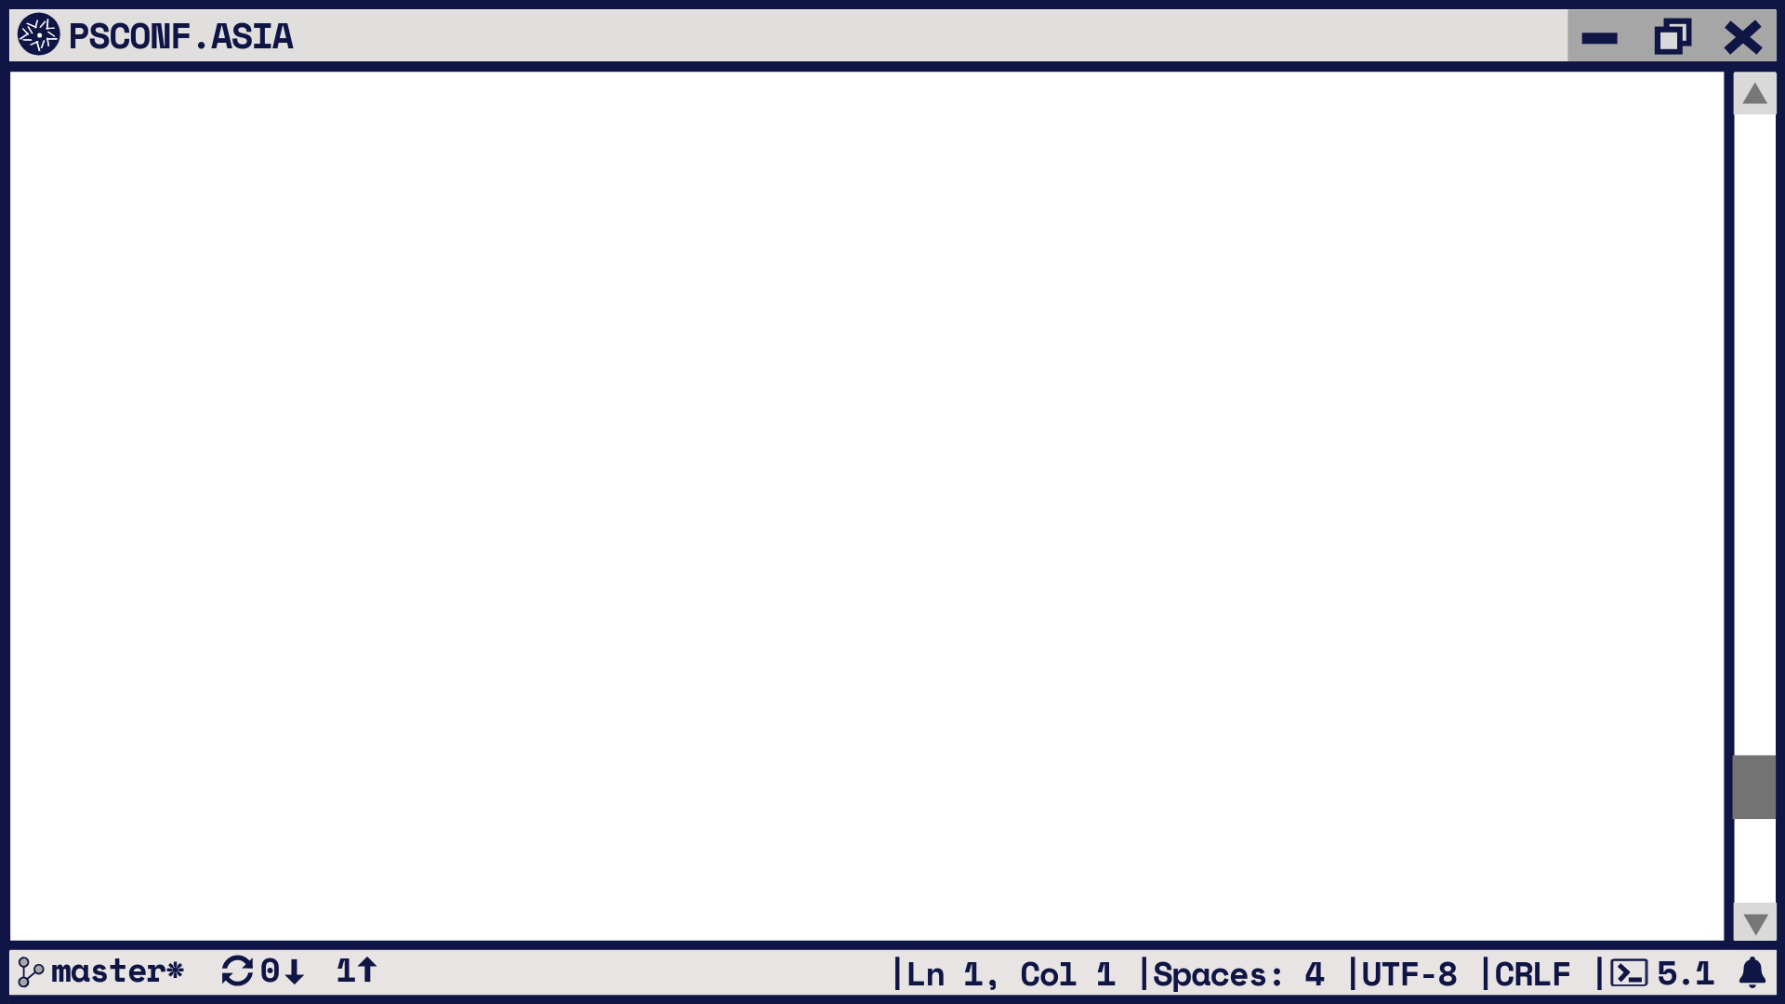
Lab Time!

Slide 34
VMware Hands On Labs
The lab for today’s workshop:
HOL-2012-01-SDC - VMware vSphere Automation – PowerCLI
Link: https://labs.hol.vmware.com/HOL/
Even after today, if you don’t have your own lab - Use ours!

Slide 35
More Advanced Topics

Slide 36
Try-Catch-Finally
The “forced” terminating error
Use Try-Catch(-Finally)
Part of your repertoire!
$vNic = Get-VM -Name $vmName | Get-NetworkAdapter -Name $nicName
if (-not $vNic)
{
$vNic = New-NetworkAdapter -VM $vmName -NetworkName $pgName -Type $nicType
}
elseif ($vNic.Type -ne $nicType)
{
$vNic = Set-NetworkAdapter -NetworkAdapter $vNic -Type $nicType -Confirm:$false
}

Slide 37
Try-Catch-Finally
try
{
$vNic = Get-VM -Name $vmName |
Get-NetworkAdapter -Name $nicName -ErrorAction Stop |
Set-NetworkAdapter -NetworkName $pgName -Type $nicType
}
catch
{
$vNic = Get-VM -Name $vmName |
New-NetworkAdapter -NetworkName $pgName -Type $nicType
}

Slide 38
Try-Catch-Finally
try
{
$vNic = Get-VM -Name $vmName |
Get-NetworkAdapter -Name $nicName -ErrorAction Stop
}
catch
{
$vNic = Get-VM -Name $vmName |
New-NetworkAdapter -NetworkName $pgName
}
finally
{
Set-NetworkAdapter -NetworkAdapter $vNic -WakeOnLan:$true -Confirm:$false
}

Slide 39
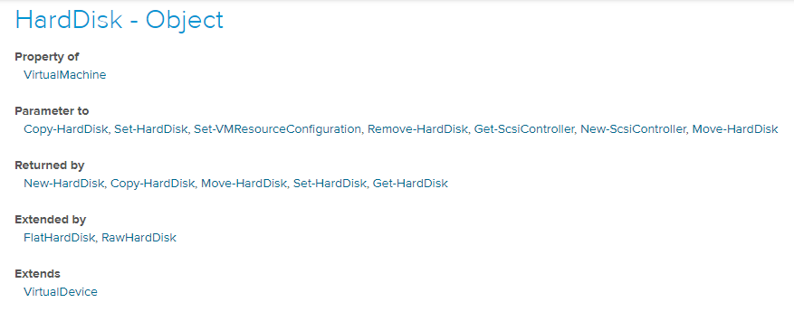
Inheritance
No, not that kind!
Most objects use an inheritance scheme

Slide 40
Interitance
Chain of objects, sum of properties
VirtualDevice
HardDisk
FlatHardDisk
ParentId
Name
Uid
Client
Id
ConnectionState
Parent
Persistence
DiskType
FileName
CapacityKB
CapacityGB
StorageFormat
RawHardDisk
DeviceName
ScsiCanonicalName
Other devices

Slide 41
Inheritance
What is in it for me?
Simplify your code
Understand why some code will not work
… and how to fix it

Slide 42
Inheritance
Get-VM -Name VM1 | Get-HardDisk |
Where-Object {
$_ -is
[VMware.VimAutomation.ViCore.Types.V1.VirtualDevice.FlatHardDisk] -or
$_ -is
[VMware.VimAutomation.ViCore.Types.V1.VirtualDevice.RawHardDisk]
}
Get-VM -Name VM1 | Get-HardDisk |
Where-Object {
$_ -is
[VMware.VimAutomation.ViCore.Types.V1.VirtualDevice.VirtualDisk]
}

Slide 43
Inheritance
Get-VM -Name VM1 | Get-HardDisk | `
Select-Object -Property Name, FileName, ScsiCanonicalName
Get-VM -Name VM1 | Get-HardDisk | Export-Csv -Path .\report.csv
Import-csv -Path .\report.csv | `
Select-Object -Property Name, FileName, CanonicalName
?

Slide 44
Inheritance
Export-Csv takes the 1st object as template, if no explicit properties given
$hd = Get-VM -Name VM1 | Get-HardDisk
$props = $hd | % { $_.psobject.properties.name } | Sort-Object -Unique
$hd | Select-Object -Property $props | Export-Csv -Path .\report.csv
Import-csv -Path .\report.csv | `
Select-Object -Property Name, FileName, ScsiCanonicalName

Slide 45
Wait For It
Template + OSCustomizationSpec ➔ VM
But when is it really available?
Use the Events (Luke)!
Simple VM deployment
$sVM = @{
Name = $vmName
Template = Get-Template -Name $templateName
ResourcePool = Get-Cluster -Name $clusterName
Datastore = Get-Datastore -Name $dsName
OSCustomizationSpec = Get-OSCustomizationSpec -Name $custName
}
New-VM @sVM | Start-VM -Confirm:$false

Slide 46
Wait For It
Analyze the timeline
$sEvent = @{
Entity = Get-VM -Name $vmName
MaxSamples = [int]::MaxValue
Start = (Get-Date).AddMinutes(-30)
}
Get-VIEvent @sEvent |
where{$_ -is [VMware.Vim.VmEvent]} |
Sort-Object -Property CreatedTime |
Select CreatedTime,@{N='Type';E={$_.GetType().Name}},FullFormattedMessage

Slide 47
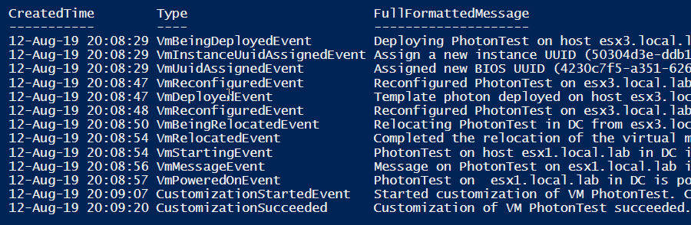
Wait For It

Slide 48
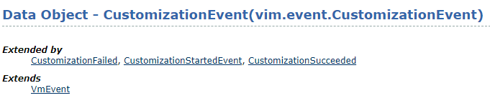
Wait For It
We wait for: Succeeded or Failed
We capture the CustomizationEvent object

Slide 49
Wait For It
1
$vm = New-VM @sVM | Start-VM -Confirm:$false
$sEvent = @{ Entity = $vm MaxSamples = [int]::MaxValue Start = (Get-Date).AddSeconds(-5) }
$condition = { $_ -is [VMware.Vim.CustomizationSucceeded] -or $_ -is [VMware.Vim.CustomizationFailed] }
Do { Start-Sleep -Seconds 5 $custEvents = (Get-VIEvent @sEvent).Where($condition) } until ($custEvents)
2
3
4

Slide 50
At Your Fingertips
How often did/do you execute any of these?
$global:DefaultViServer
$PSVersionTable
pwd
Get-Module –Name VMware.PowerCLI –ListAvailable
…
Useful while coding and when asking for guidance
Can be automated

Slide 51
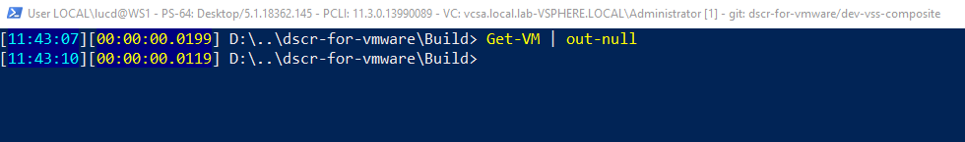
At Your Fingertips
Meet your “power(cli)” profile
A lot of info at your fingertips
PS version
vSphere Server
User/Admin
Account/Host
PowerCLI version
Repo/branch
Current time
Execution time
Current folder

Slide 52
At Your Fingertips
function prompt { # Shorted PWD $path = $pwd.Path.Split(‘\’) if ($path.Count -gt 3) { $path = $path[0], '..', $path[-2], $path[-1] } Write-Host -Object "$($path -join '\')" –NoNewline }

Slide 53
At Your Fingertips
if ($global:defaultviserver) { $vcObj = (Get-Variable -Scope global -Name 'DefaultVIServer').Value if ($vcObj.ProductLine -eq 'vpx’){ $vcSrv = 'VC’ } else{ $vcSrv = 'ESXi’ } $vc = " - $($vcSrv): $($vcObj.Name)-$($vcObj.User)” $vc = “[$($global:DefaultVIServers.Count)]” }
# Update the Window's title $host.ui.RawUI.WindowTitle = "$user$ps$pcli$vc$gitStr"

Slide 54
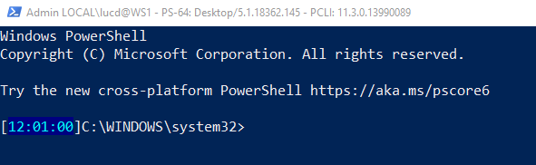
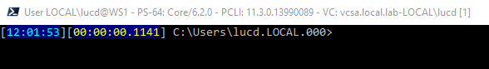
At Your Fingertips

Slide 55
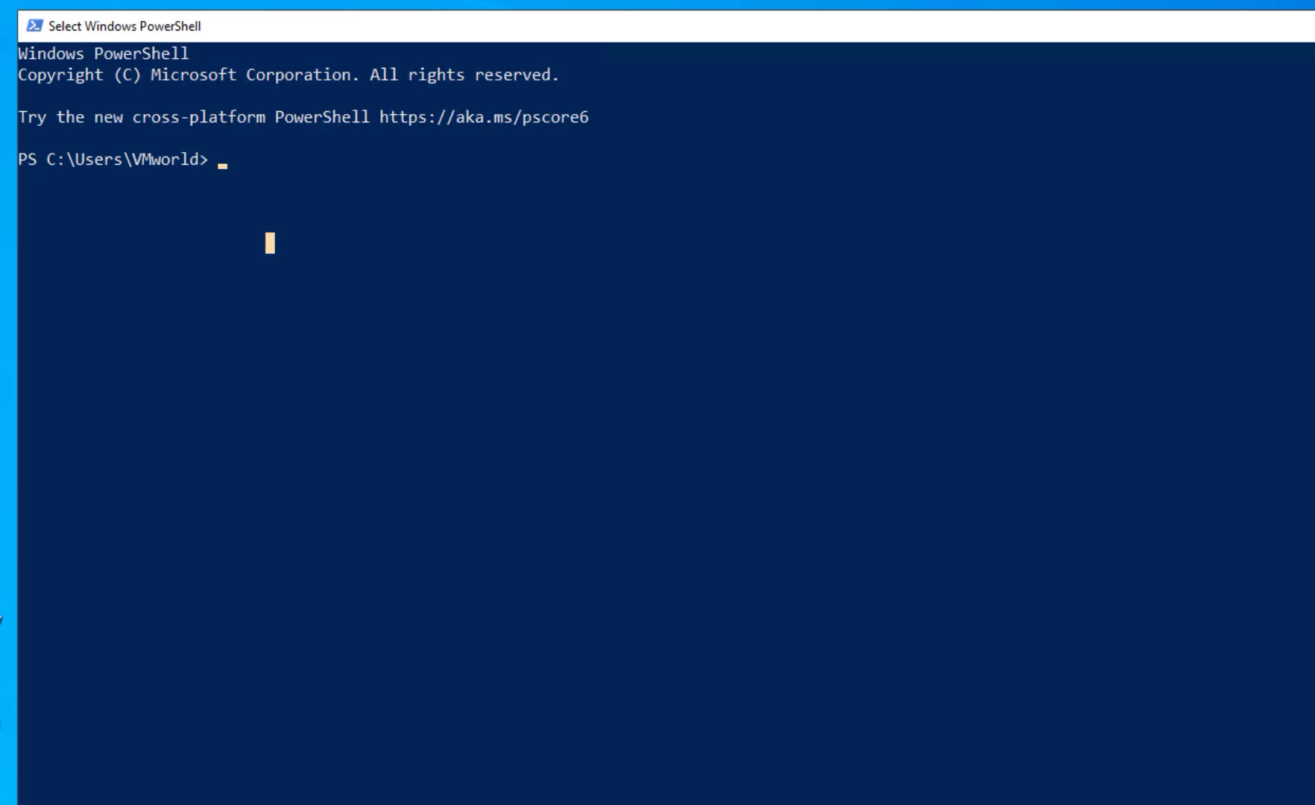

Slide 56
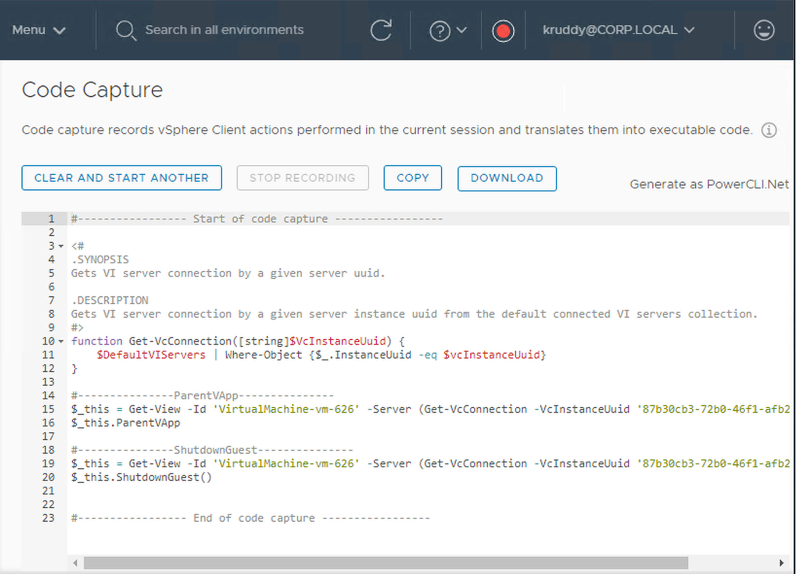
Code Capture
Turn UI Actions into Executable Code
Available
vSphere 6.7 U2
vSphere HTML 5 Fling
Currently Supports vSphere 6.5
Output Type: PowerCLI
Never use as-is!
Refer to Code Later
Copy to Clipboard
Download as Script

Slide 57
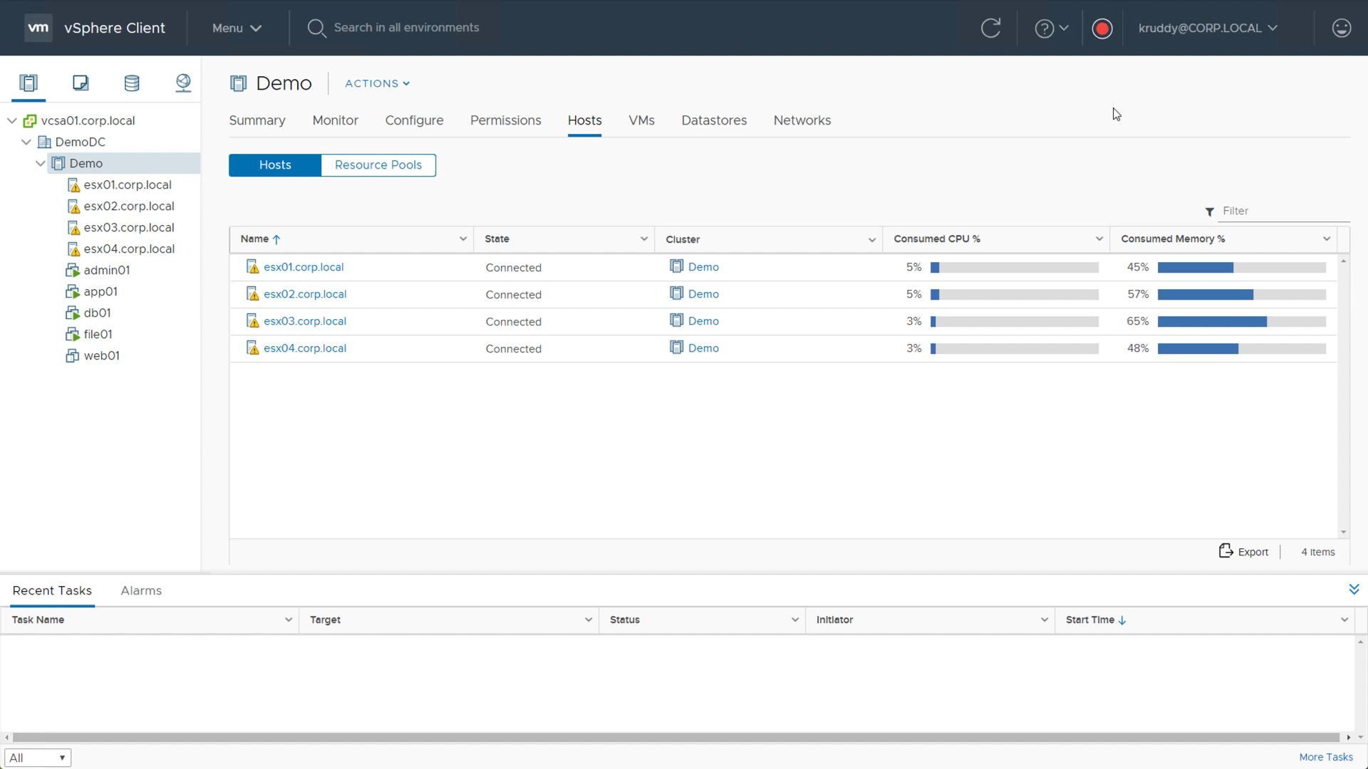

Slide 58
Additional Information
Make use of the community:
VMware PowerCLI Community: https://vmware.com/go/powercli
VMware Code Slack Group: https://code.vmware.com/web/code/join
Example Scripts:
Community Repo: https://github.com/vmware/PowerCLI-Example-Scripts
Sample Exchange: https://code.vmware.com/samples

Slide 59
Additional Information
The Complete Guide to PowerShell Punctuation
https://www.simple-talk.com/sysadmin/powershell/the-complete-guide-to-powershell-punctuation/
PowerCLI Info Page: https://code.vmware.com/tool/vmware-powercli
Includes: Cmdlet Reference, User Guide, Change Log, Release Notes

Slide 60
